Slide 2
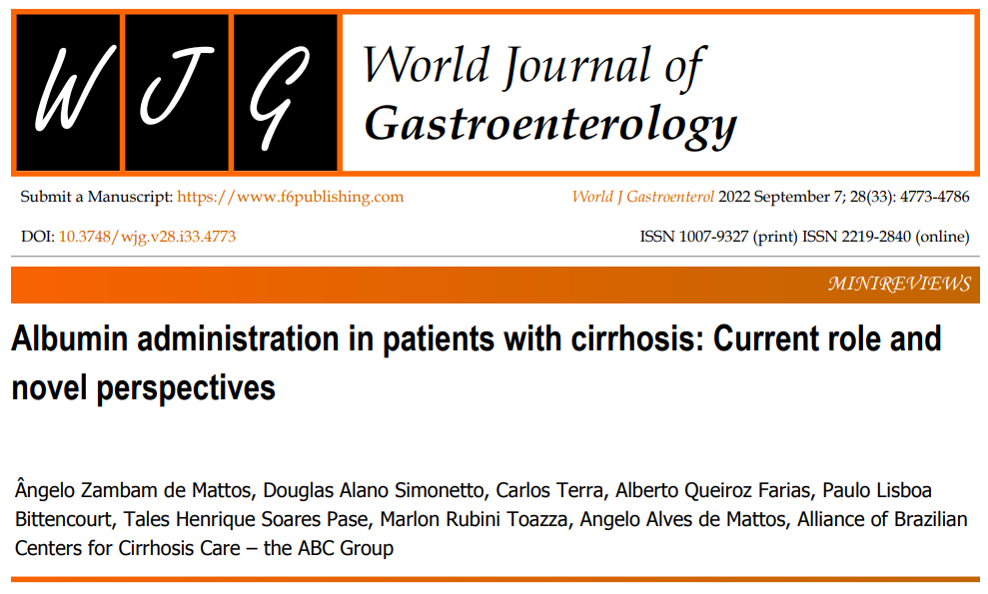

Slide 3
INTRODUCTION
Cirrhosis and chronic liver diseases rank as the conditions with the 10th highest mortality rate worldwide.
Deaths are mostly related to the development of clinical decompensation of cirrhosis, and 4%–12% of individuals with cirrhosis present with at least one episode of decompensation annually.
Albumin administration has been studied in the prophylaxis and management of different forms of decompensation of cirrhosis for many years.
Albumin has multiple roles, including oncotic, anti-oxidative, detoxifying, anti-inflammatory, endothelium stabilizing, and immunomodulatory functions.
Traditionally, most decompensating events of cirrhosis were explained by the peripheral arterial vasodilation hypothesis, and albumin was considered potentially useful mainly due to its oncotic property, as it is responsible for 75% of plasma oncotic pressure.

Slide 4
Objective
This article reviews the current role and novel perspectives for albumin administration in cirrhosis.

Slide 5
Large Volume Paracentesis
Large volume paracentesis (LVP) is the current standard of care for the management of refractory and tense ascites due to its efficacy and low rate of complications.
The drainage of large volumes of ascetic fluid increases cardiac output and reduces peripheral vascular resistance and effective circulating volume, leading to arterial hypotension, acute kidney injury (AKI), hepatic encephalopathy (HE), worsening of hyponatremia, and decreased survival rates.
This severe condition is termed paracentesis-induced circulatory dysfunction (PICD) and is defined by a rise of more than 50% in the basal plasma renin activity a few days after the procedure, indicating the detrimental effect of volume depletion on effective volemia.
Several randomized controlled trials (RCTs) have shown that PICD can be prevented by intravenous human albumin administration, particularly in cases of paracentesis exceeding 5 L and that albumin is more effective than other plasma expanders.

Slide 6
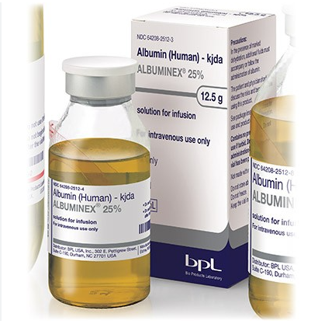
Large Volume Paracentesis
In the seminal study for instance, 105 patients were randomized to be submitted to paracentesis with or without
albumin infusion, and individuals receiving
albumin developed less episodes of
hyponatremia (P < 0.01) and renal impairment
(P < 0.05).

Slide 7
Large Volume Paracentesis
In 2012, a meta-analysis of 17 RCTs, including 1225 patients with ascites undergoing LVP, showed that in comparison to alternative treatments
Albumin reduced the incidence of PICD [odds ratio = 0.39, 95% confidence interval (CI): 0.27-0.55],
Hyponatremia (odds ratio = 0.58, 95%CI: 0.39–0.87),
and mortality (odds ratio = 0.64, 95%CI: 0.41–0.98),
which appeared to be definitive evidence regarding the role of albumin infusion in LVP.

Slide 8
Large Volume Paracentesis
However, in 2019 another meta-analysis, including 25 RCTs, revisited this issue.
According to this systematic review, there was no evidence of significant reduction in mortality or renal impairment when any volume expansion was compared to no volume expansion at all, but it should be highlighted that only one and two RCTs using albumin actually contributed to the analyses of these outcomes, respectively:
When albumin was compared to other plasma expanders, there were significant benefits of using albumin regarding prevention of PICD [risk ratio (RR) = 1.98, 95%CI: 1.31–2.99]
and hyponatremia (RR = 1.49, 95%CI: 1.03–2.14),
but there was no evidence of significant differences between treatments regarding renal impairment (RR = 1.17, 95%CI: 0.71–1.91) and mortality (RR = 1.03, 95%CI: 0.82–1.30).

Slide 9
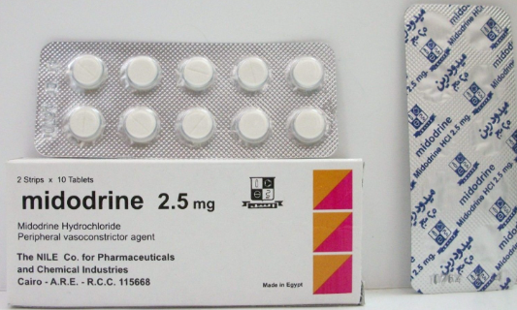
Large Volume Paracentesis
An RCT compared the effect of Midodrine and standard albumin doses in preventing PICD in 50 patients with cirrhosis and tense refractory ascites.
Midodrine therapy was associated with higher incidence of AKI, worsening of hyponatremia, and higher plasma renin activity and plasma aldosterone concentration, suggesting that this drug is not as effective as intravenous albumin in preventing PICD after LVP.

Slide 10
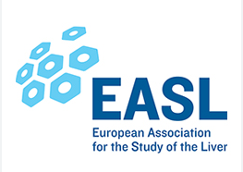
Large Volume Paracentesis
8 g / L Ascitic Fluid
6-8 g / L Ascitic Fluid

Slide 11
Large Volume Paracentesis
A recent study randomized 80 subjects with ACLF undergoing paracentesis < 5 L to receive standard doses of albumin or no fluid expansion and demonstrated that
PICD was significantly more common in the control group than in the albumin group (70.0% vs 30.0%, P = 0.001),
with significantly higher incidences of HE (50.0% vs 27.0%, P = 0.04),
hyponatremia (67.5% vs 22.5%, P < 0.001),
AKI (62.5% vs 30%, P = 0.001),
and short-term mortality (62.5% vs 27.5%, P = 0.003).

Slide 12
AKI and Hepatorenal Syndrome
The diagnostic criteria of AKI in cirrhosis have evolved over the years and are currently based on an acute increase in serum creatinine by ≥ 0.3 mg/dL or ≥ 50% from baseline.
Hypovolemia accounts for about one-half of all cases of AKI in cirrhosis, and it is often driven by excessive use of diuretics and/or fluid losses from lactulose-induced diarrhea.
In addition to diuretic withdrawal, intravenous albumin at 1 g/kg/d (maximum 100 g/d) for 2 d has been recommended for volume expansion, especially in patients with AKI stage ≥ 1b since mortality appears to significantly increase from this stage on.
The benefits of albumin in HRS, a functional kidney injury driven by reduction in renal blood flow, extend beyond just plasma volume expansion.

Slide 13
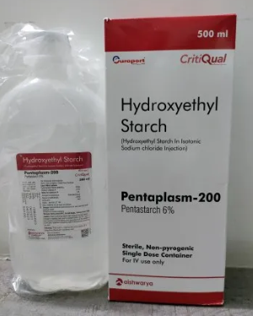
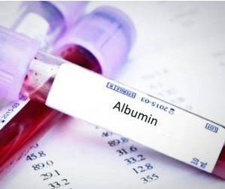
AKI and Hepatorenal Syndrome
This has been demonstrated in a study comparing albumin with hydroxyethyl starch, a synthetic colloid, in patients with spontaneous bacterial peritonitis (SBP).
Administration of albumin resulted in significant improvement
on systemic hemodynamics, whereas this effect
was not appreciated in the starch group.

Slide 14
AKI and Hepatorenal Syndrome
Although albumin alone has a limited role in HRS–AKI, the benefit of added albumin to vasoconstrictor therapy in HRS has been demonstrated in one nonrandomized study comparing terlipressin with terlipressin plus albumin.
Despite being a small study, it demonstrated that the combination therapy group had a significantly higher response rate compared to terlipressin monotherapy (77% vs 25%, P = 0.03).

Slide 15
AKI and Hepatorenal Syndrome
This concern has been raised in the recently published study, a large RCT comparing terlipressin with placebo.
Concomitant albumin was given in > 80% of patients in both arms at a mean total dose of 200–240 g over 5 d (40–50 g/d).
A higher incidence of respiratory failure was observed
in the terlipressin group (14% vs 5%), presumably
secondary to pulmonary edema because of
the known cardiovascular effects of terlipressin
in combination with excessive albumin use.

Slide 16
SBP
Bacterial infections occur in 25%–35% of the patients hospitalized with advanced cirrhosis, and they are associated with increased morbidity and mortality, particularly when acquired in the hospital or in healthcare facilities, due to the presence of multidrug resistant organisms.
SBP is frequently reported as the most common infection in subjects with cirrhosis and ascites and one of the main precipitants of ACLF. It is diagnosed in the presence of a polymorphonuclear cell count > 250/mm3 in the ascitic fluid, and it is usually treated with third-generation cephalosporins in those patients with community-acquired infection.

Slide 17
SBP
However, since the publication of the pivotal RCT by Sort et al in 1999, it is clear that this infection should not be treated exclusively with antibiotics.
In that study, 126 hospitalized patients with SBP were randomized to receive intravenous cefotaxime versus intravenous cefotaxime plus albumin administered at a dose of 1.5 g/kg body weight at baseline, followed by 1 g/kg on day 3.
The authors described a threefold reduction in the incidence of renal impairment favoring the albumin group (33% vs 10%, P = 0.002).
More importantly, 3-mo mortality was also significantly lower in the albumin group (41% vs 22%, P = 0.03),
which was attributed to the decrease in the incidence of AKI.

Slide 18
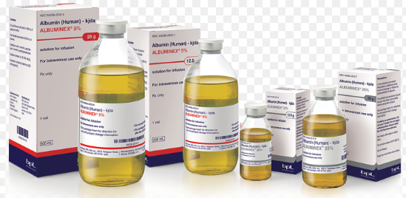
SBP
The benefit of using albumin in SBP was initially attributed to plasma expansion and/or prevention of circulatory dysfunction, but it actually seems that albumin infusion leads to a reduction of plasma levels of nitric oxide, tumor necrosis factor-α, endotoxin and interleukin-6.
These findings favor the concept that albumin is more than a colloid and that it has anti-inflammatory properties in individuals with decompensated cirrhosis.

Slide 19
SBP
In one study, renal impairment was negligible in both groups of patients in the presence of baseline bilirubin levels < 4 mg/dL and serum creatinine level < 1 mg/dL,
Suggesting that albumin administration might be restricted to higher-risk subjects.
Nevertheless, subsequent data have disputed those findings.

Slide 20
SBP
A meta-analysis including four RCTs evaluated the role of albumin in SBP and concluded that albumin was associated with a lower incidence of renal impairment and mortality, not identifying a significant difference in albumin effects according to baseline levels of bilirubin or renal function

Slide 21
Extraperitoneal Infections
Infections (not only SBP) characterize state 6 (end-state) in the clinical course of cirrhosis, as they increase the risk for AKI, HRS, organ failure, and ACLF.
It has also been recently demonstrated that infections are the most important precipitating factor for acute decompensation of cirrhosis, even in patients without ACLF.
On the other hand, in compensated cirrhosis, the role of infections is not completely understood.

Slide 22
Extraperitoneal Infections
A recent cohort study has demonstrated that 17% of patients with compensated cirrhosis developed infections, particularly respiratory and urinary tract infections, which led to decompensation of cirrhosis in 26% of cases and to an increased mortality rate.
Therefore, considering the importance of infections in the prognosis of cirrhosis, improving the efficacy of therapeutic strategies would be of the utmost importance.
In SBP, as previously discussed, the addition of albumin to antibiotic treatment represented an important improvement in the therapeutic strategy, and it was natural to study if a similar intervention could reach the same results in extra-peritoneal infections.

Slide 23
Extraperitoneal Infections
In the first of them, patients with cirrhosis and extra-peritoneal infections were randomized to receive antibiotics plus albumin (same doses as for SBP) or antibiotics alone, and albumin led to improved circulatory and renal functions.
In that study, there was no significant difference in 3-mo survival between groups, but albumin use was an independent predictive factor of survival after adjusting for other factors.

Slide 24
Extraperitoneal Infections
In the second RCT, despite delaying the onset of renal failure, albumin was not able to significantly reduce its incidence or improve survival.
Besides, 8.3% of subjects receiving albumin developed pulmonary edema as a complication.

Slide 25
Extraperitoneal Infections
In the third RCT, albumin was associated with a higher resolution of ACLF as well as with lower incidence of nosocomial infections.
An important limitation of this study is the fact that only 23% of the estimated sample was actually enrolled in the trial.

Slide 26
Extraperitoneal Infections
In order to further examine this subject, our group has performed a meta-analysis of RCTs evaluating the role of albumin in extra-peritoneal infections.
In that meta-analysis, there was no evidence of significant benefit of albumin in
reducing renal dysfunction (RR = 0.55, 95%CI: 0.25–1.19, P = 0.13)
or mortality in 30 d (RR = 1.62, 95%CI: 0.92–2.84, P = 0.09)
and 90 d (RR = 1.27, 95%CI: 0.89–1.83, P = 0.19).

Slide 27
LONG-TERM ALBUMIN ADMINISTRATION
Ascites is the most common among severe complications of cirrhosis, and it marks state 4 in the natural history of this disease.
Ascites is associated with a 5-year mortality of 50%, and persistent ascites predicts mortality independently of the Model for End-Stage Liver Disease score.
Therefore, strategies aiming at the increase in survival of patients with cirrhosis and ascites are constantly pursued. Long-term albumin administration has been studied in the management of patients with cirrhosis and ascites for many decades.
The rationale for its use relies on the hypothesis that albumin could reduce effective arterial hypovolemia through plasma expansion and that the nononcotic properties of albumin could act against the systemic inflammation that is behind decompensation of cirrhosis.
Once again, the concept of effective albumin concentration should be highlighted in this context.
As albumin is quantitatively and qualitatively deficient in cirrhosis, leading to alterations in the transport and metabolism of substances as well as to the impairment of systems associated with the redox balance, inflammation, and coagulation, it is hypothesized that albumin supplementation could prevent the decompensation of cirrhosis.

Slide 28
LONG-TERM ALBUMIN ADMINISTRATION
Five RCTs evaluated the role of long-term albumin administration in patients with cirrhosis and ascites.
The first study evaluated a small sample of subjects with persistent ascites already under treatment with diuretics.
Albumin was used at doses of 25–100 g every 1–2 d according to serum colloid osmotic pressure, and 25–100 g every 1–2 wk thereafter.
The osmotic pressure was improved in individuals receiving albumin, but mortality was not different between groups.

Slide 29
LONG-TERM ALBUMIN ADMINISTRATION
After that, two Italian RCTs evaluated the matter. Gentilini’s study enrolled patients with ascites unresponsive to a low-sodium diet, while Romanelli studied individuals with their first episode of grade 2–3 ascites.
Both studies randomized patients to receive albumin at doses of 25 g every week for 12 mo and every other week thereafter.
In the former study, albumin led to significantly lower cumulative probabilities of recurrence of ascites and hospitalization, but there was no benefit regarding mortality.
In the latter, though, patients receiving albumin had a significantly lower probability of recurrence of ascites and a higher cumulative survival rate.

Slide 30
LONG-TERM ALBUMIN ADMINISTRATION
Finally, in 2018, two more RCTs on long-term albumin administration were published.
Solà evaluated albumin at doses of 40 g twice a month in combination with midodrine for patients with cirrhosis and ascites in the waiting list for liver transplantation, but there was no significant difference in survival or in complications of cirrhosis between study groups.
On the other hand, Caraceni randomized patients with persistent ascites to receive albumin 40 g twice a week for 2 wk and once a week thereafter or no plasma expansion.
Individuals receiving albumin had significantly better results than their counterparts regarding mortality, need for paracentesis, SBP, extra-peritoneal infections, HE, renal dysfunction, HRS, hyponatremia, and hyperkalemia.

Slide 31
LONG-TERM ALBUMIN ADMINISTRATION
Pooling the data from all five RCTs, it was demonstrated that albumin significantly reduced recurrence of ascites/need for paracentesis (RR = 0.56, 95%CI: 0.48–0.67, P < 0.001).
There was also a trend towards a lower risk of mortality favoring albumin, but it did not reach statistical significance (RR = 0.88, 95%CI: 0.67–1.14, P = 0.33).
There was no evidence of significant differences between groups regarding refractory ascites, SBP, HE, gastrointestinal bleeding, or adverse events.

Slide 32
LONG-TERM ALBUMIN ADMINISTRATION
In a recent study, the effects of different doses of long-term albumin administration were compared.
While high-dose albumin (1.5 g/kg/wk) led to normalization of serum levels of albumin, improvement of circulatory and cardiac function, and reduction in plasma levels of cytokines, low-dose albumin (1.0 g/kg every 2 wk) did not.
It is noteworthy that the trial by Caraceni was the one using the highest dose of albumin among the five RCTs on this issue, and, even so, the dose used was only slightly higher than that considered insufficient in the abovementioned study.
Moreover, while changes in serum levels of albumin were not different between groups in the trial by Solà, the intervention group had a normalization of serum albumin in the study by Caraceni which reinforces the idea of insufficient doses of albumin in the former trial.

Slide 33
LONG-TERM ALBUMIN ADMINISTRATION
Furthermore, in a post hoc analysis of the study by Caraceni , the authors demonstrated that a serum level of albumin of 4 g/dL at 1 mo should be the target in long-term albumin administration in order for the highest survival rates to be achieved.
In that publication, the authors suggested the hypothesis of the albumin gap, associating the amount of albumin required not only to baseline albumin levels but also to the severity of liver disease and highlighting the importance of the concept of effective albumin concentration.

Slide 34
Other Indications

Slide 35
Decompensated cirrhosis
A recent RCT (the ATTIRE study), including 777 patients hospitalized for decompensated cirrhosis with baseline serum albumin levels < 3 g/dL, evaluated the effects of increasing these levels by daily intravenous administration of albumin.
In that study, albumin administration was not superior to placebo in preventing a composite endpoint of infection, AKI and death. Nevertheless, there are important points to consider.
Ascites relates to the severity of circulatory dysfunction in patients with advanced cirrhosis.
Although ascites was present in 62% of patients in the albumin group and in 71% in the control group, there was no information about its grade, the percentage of individuals with refractory ascites, use of diuretics, and their doses.
Furthermore, there were no data on serum sodium concentration, another important marker of circulatory dysfunction;
there were no data on the severity or type of infections and their effects on circulatory function.

Slide 36
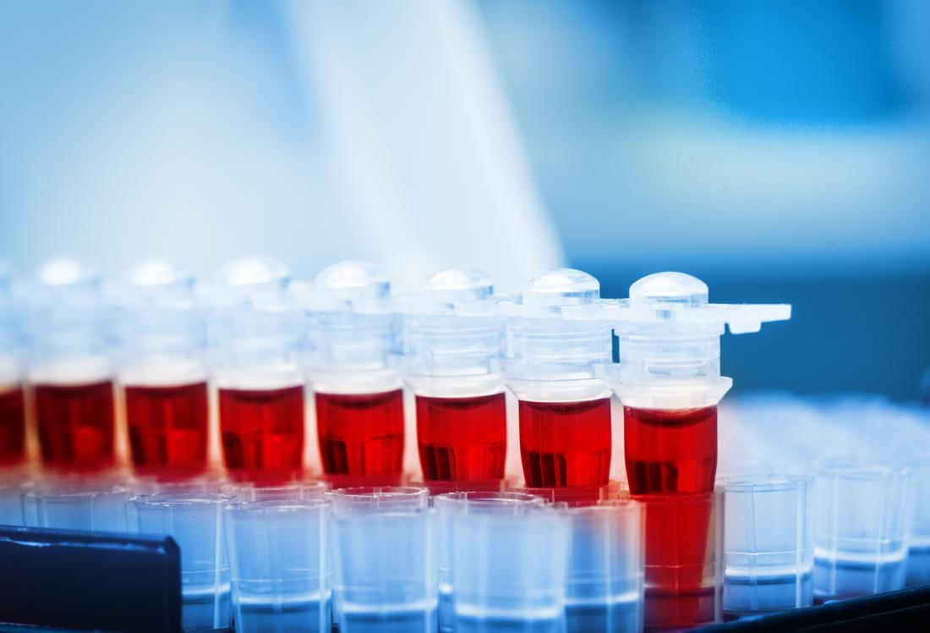
HE
Besides the traditional concept that implies cerebral exposure to ammonia as the basic mechanism for HE occurrence, new proposals suggest that the activation of inflammatory mediators, cerebral blood flow alterations due to circulatory dysfunction, and oxidative stress altogether contribute to the astrocytic injury leading to HE.
Albumin, a multifunctional protein, as previously mentioned in this review, could therefore play an important role in the treatment of HE.

Slide 37
HE
In 2004, a pilot study evaluated the effects of plasma expansion with albumin in patients with cirrhosis and diuretic-induced HE.
Albumin was more effective than a gelatin-based colloid solution in improving HE grade and lowering plasma concentrations of malondialdehyde, an oxidative stress marker.
After that pilot study, a multicenter, double-blind RCT found no significant differences between albumin or saline solution in the resolution of HE in patients with cirrhosis hospitalized with this complication.
However, the same study demonstrated a significant improvement in 90-d survival in the albumin group (69.2% vs 40.0%, P = 0.02).

Slide 38
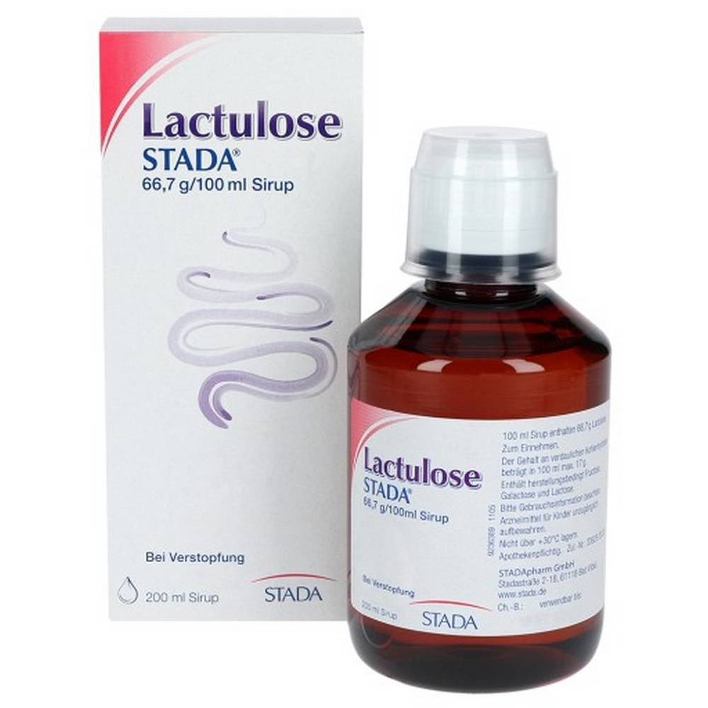
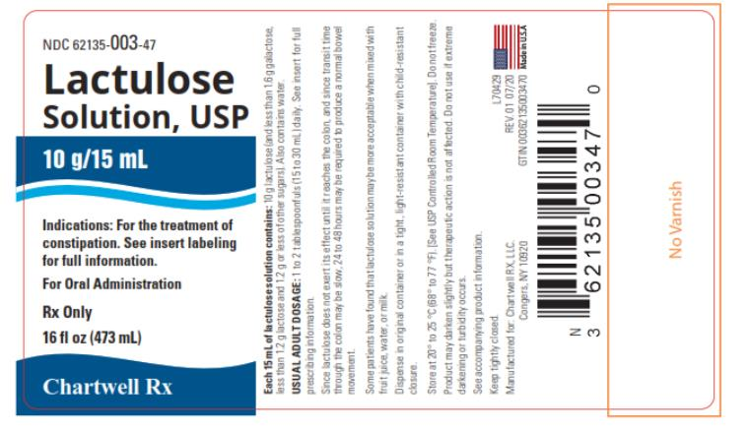
HE
In yet another RCT that compared lactulose plus albumin (group 1) versus lactulose alone (group 2) for the treatment of HE, 75% of patients in group 1 and only 53% of those in group 2 had complete reversal of HE (P = 0.03).
Moreover, mortality was significantly lower in group 1 (18.3% vs 31.6%, P = 0.04).

Slide 39
HE
A recent meta-analysis of RCTs aimed at clarifying the role of albumin in HE.
In that study, albumin administration was able to significantly improve HE (RR = 0.60, 95%CI: 0.38–0.95, P = 0.03)
and mortality (RR = 0.54, 95%CI: 0.33–0.90, P = 0.02).

Slide 40
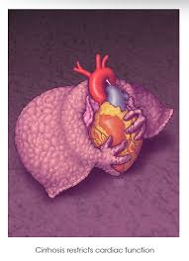
Cirrhotic cardiomyopathy
Albumin seems to prevent cardiac output reduction and plasma renin activity increase in patients with cirrhosis more effectively than other plasma expanders.
The increase in cardiac output induced by albumin seems to be independent of volume expansion, which might be explained by the reversal of the negative effects of tumor necrosis factor-alpha and oxidative stress on cardiac contractility.

Slide 41
ACLF
Considering the exacerbated systemic inflammatory state associated with the pathophysiology of ACLF and the anti-inflammatory properties of albumin, it could be hypothesized that albumin might play a role in the treatment of ACLF.
There are limited data on this issue at the moment, but an RCT on albumin in extra-peritoneal infections has demonstrated that individuals receiving this intervention had higher rates of ACLF resolution than their counterparts.
Moreover, subjects receiving albumin had evidence of suppression of the systemic inflammation (decrease in white blood cells, C reactive protein, and interleukin-6), which was not specific for those with ACLF.
On the other hand, there remains a concern that administered albumin could be modified and added up to the pool of pathological albumin of such severely ill patients.
It is noteworthy that patients with cirrhosis, particularly those with advanced disease, have an impairment of albumin function in all of its domains and, therefore, a reduction in effective albumin concentration.

Slide 42
PREDICTION OF RESPONSE TO ALBUMIN ADMINISTRATION
Not all patients receiving albumin will benefit from it, and biomarkers capable of identifying those most likely to benefit from it would be extremely useful.
Effective albumin concentration, which reflects the portion of the albumin pool with normal structure and function, is superior to total albumin in stratifying individuals with compensated cirrhosis, acute decompensation, or ACLF as well as in distinguishing patients with or without complications of cirrhosis.
Therefore, effective albumin concentration seems to be promising as a predictor of prognosis and treatment response in these patients.

Slide 43
Adverse Events
Albumin infusion is generally safe, but careful evaluation of the patient is necessary in order to avoid complications, particularly volume overload and pulmonary edema.
Other uncommon complications of albumin
might relate to contamination by blood-derived
pathogens as well as to its administration to
individuals allergic to albumin and to those
with severe anemia, severe coagulopathy
with pulmonary hemorrhage, or with
subcutaneous bleeding.

Slide 44
Economic Aspects
albumin administration was proven cost-effective in different settings when evaluated using a decision-tree economic model.
In that study, when compared to saline, gelatin, and no fluid expansion, albumin was the dominant treatment (more effective and less costly) for patients undergoing LVP.
Regarding individuals with SBP, combining albumin and antibiotics was more cost-effective than using antibiotics alone in all three evaluated countries, and it was the dominant strategy in two of them.
Finally, in HRS, combining albumin and a vasoconstrictor was the dominant strategy when compared to using a vasoconstrictor alone.
Therefore, the concept of albumin administration being costly should be revisited since it is not only cost-effective but also cost-saving in most settings.

Slide 45
Conclusion
Due to the pathophysiological mechanisms behind decompensations of cirrhosis, albumin plays an important role in their prevention and management through its oncotic and non-oncotic properties.
International medical societies have made formal evidence-based recommendations for albumin administration in LVP, AKI, HRS and SBP.
Promising evidence suggests that long-term albumin in patients with ascites, albumin in modest-volume paracentesis in individuals with ACLF, and albumin in HE are also probably beneficial.
Further studies are needed to elucidate the role of albumin in other clinical scenarios, such as extra-peritoneal infections, decompensated cirrhosis with hypoalbuminemia, and hyponatremia.

Slide 46
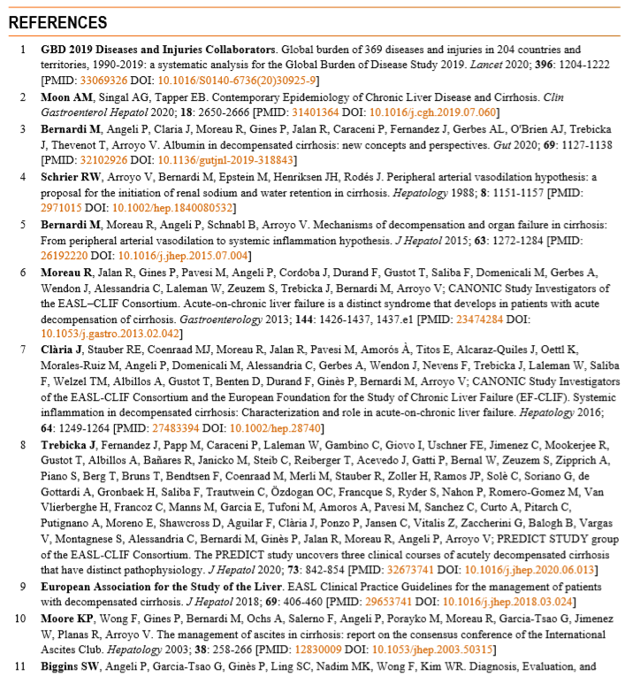

Slide 50
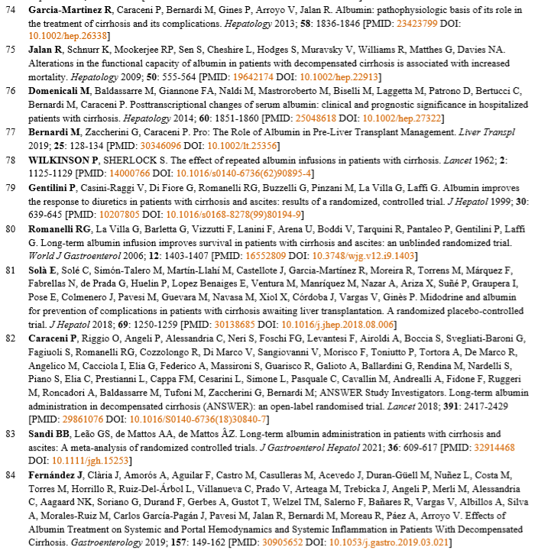

Slide 51
